Slide 1

Team and Problem Statement
Ministry : Ministry of Home Affairs
PS Code: 1412 Problem Statement Title: Data Compression for backbone network
Team Name: ammoGDevs Team Leader Name: Hemal S Institute Code (AISHE): Institute Name: Dayananda Sagar University, Bengaluru
TeM Name: Blockchain and Cybersecurity

Slide 2
Idea/Approach Details
Technology stack:
1. Data Collection and Processing
-Language: Python
-Libraries: Pandas, NumPy
2. Machine Learning/Recommendation Model
-Libraries: Scikit-learn
3. File Handling and Metadata Extraction:
-Libraries: Specialized libraries for different file types (e.g., Pillow for images, PyPDF2 for PDFs).
4. Compression Algorithms:
-Text-Huffman and Run Length Encoding5.
Video-H.264(AVC-Advanced Video Coding)
Audio-MP3 (MPEG-1 Audio Layer III), AAC
User Interface :
-Libraries: Tkinter or PyQt,Figma
6. Testing and Deployment:
-Testing: Unit testing libraries like unittest or pytest
-Deployment :WEBSITE THAT ACTS AS AN ENABLER
Solution:
To encounter this problem, we are developing a tool which will efficiently recommend the data compression algorithm preferable for the user input of file type and size to be sent and his preference, ultimately optimize network performance. The software will be designed to adapt to the unique characteristics of the network environment, ensuring seamless integration and minimal disruption to existing network operations.

Slide 3
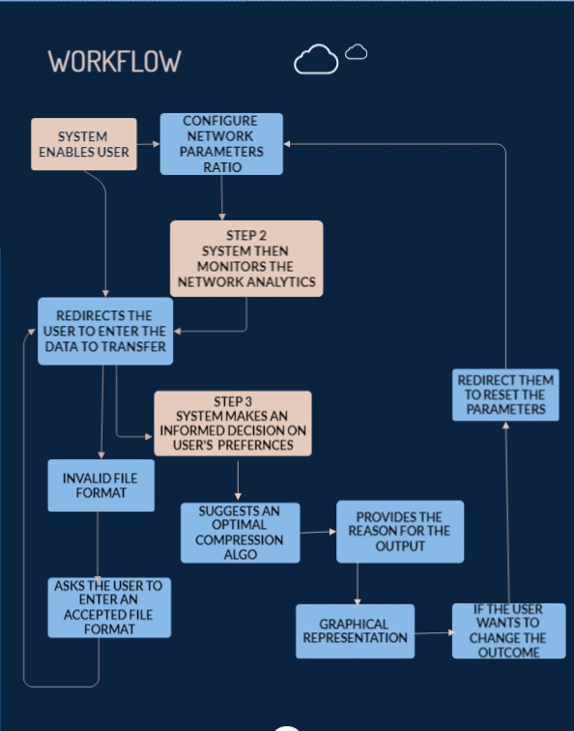
Idea/Approach Details
Use Cases Scenario
As an administrator, I log in to the dashboard.
I configure the system to use custom compression algorithms tailored to our network traffic.
The system recommends the compression algorithm based on file size, type and other preferences entered by the user while transferring data
Real-time monitoring shows the performance improvements, such as latency reduction and increased throughput.
Our security measures ensure data remains confidential during transmission.

Slide 4

Idea/Approach Details
POTENTIAL SHOWSTOPPERS
DEPENDENCIES
1. Programming Language and Environment: Choose a suitable programming language (e.g., Python) and set up the development environment.
2. Data Collection and Processing: Libraries for handling different file types and extracting metadata from data packets.
3. Statistical Analysis and Machine Learning: Libraries for building and training the recommendation model (e.g., scikit-learn, TensorFlow).
4. Algorithm Development: Libraries for implementing and testing compression algorithms (e.g., zlib, specialized image or video compression libraries).
5. Networking Libraries: Tools for network communication, like sockets or higher-level network libraries.
Lack of Sufficient Data: Insufficient historical data on user preferences and network conditions can hinder algorithm accuracy.
Dynamic Network Conditions: Adapting to fluctuating bandwidth, latency, and congestion in real-time can be challenging.
Diverse File Types and Sizes: Balancing the effectiveness of compression techniques for different file types and sizes is complex.
Resource Constraints: Ensuring compatibility with the network's available hardware and computational resources is crucial.
Algorithm Efficiency: The algorithm must process recommendations in real-time or near-real-time, especially in high-traffic networks.

Slide 5
Team Member Details
Team Leader Name: HEMAL S
B.Tech | Computer Science and Technology | III Year
Team Member 1 Name: Allan Dsouza
B.Tech | Computer Science and Technology | III Year
Team Member 2 Name: Jaice S Joseph
B.Tech | Computer Science and Technology | III Year
Team Member 3 Name: Shashank Hegde
B.Tech | Computer Science and Technology | III Year
Team Member 4 Name: Swaroop K R
B.Tech | Computer Science and Technology | III Year
Team Member 5 Name: Swathi S
B.Tech | Computer Science and Technology | III Year
Team Mentor 1 Name: Dr.Bhaskar Venugopalan
Category (Academic/Industry):
Expertise (AI/ML/Blockchain etc):
Domain Experience (in years):
Team Mentor 2 Name: Type Your Name Here
Category (Academic/Industry):
Expertise (AI/ML/Blockchain etc):
Domain Experience (in years):

